Slide 1
Real time static gesture detection using Machine Learning
From: Sandipgiri Goswami
Student #: 0362577

Slide 2
About Sign Language:
People of group use symbolic language to communicate with other people. This symbolic language is call sign language.
Sign Language is a build for communication used worldwide among hearing, hard of hearing, and deaf peoples.
Sign language is not a unique language signed consistently in different country.
Different counties have their own sign language such as American Sign Language, French Sign Language, Indian Sign Language and Puerto Rican Sign Language to a name few.
Gesture based communication is dependent on region and has significant differences from other languages.

Slide 3
About Sing Language
Sign Language is a language which uses to convey message by hand movements, facial expression and body language to communication.
It is mainly used by deaf and people who can hear but cannot speak.
Sometime family member and relatives must learn sign language to interpreters which enable deaf and wider communities to communicate with each other.

Slide 4
Different Sign Language in the Americas
North America | Central America | South America
•American Sign Language •Inuit Sign Language •Quebec Sign Language •Puerto Rican Sign Language | •Costa Rican Sign Language •Guatemalan Sign Language •Honduras Sign Language •Mayan Sign Language •Mexican Sign Language •Nicaraguan Sign Language •Panamanian Sign Language •Salvadorian Sign Language •Tijuana Sign Language | •Argentine Sign Language •Bolivian Sign Language •Brazilian Sign Language •Chilean Sign Language •Colombian Sign Language •Ecaudorian Sign Language •Paraguayan Sign Language •Peruvian Sign Language •Uruaguayan Sign Language •Venezuelan Sign Language

Slide 5
Misunderstandings about Sign Language
Most people who are not disable think that sing language is just simple a manual representation of the spoken language which is not true.
In fact, our language and sign language of the deaf have little in common.
Sing language has the difficulty of the verbal language but it is self-determining from the alphabets
The best example is British Sign Language and American Sign Language which are meaningless although the facts that disable people from United States and Britain perfectly understand each other.
Another common misunderstanding about sing language is that it globally understandable which is of course not true. As explained above, the sing language that is used by the deaf in Unites States and Britain are very not the same

Slide 6
Objective:
My thesis main objective to help deaf community to increases their self-esteem and IQ level and improve their communication skill. Student who are deaf or have a deaf parent or have a close relative with deaf individual will learn by themselves about sign language alphabets and numbers.
Deaf community will learn their first step toward to American sign language. Although correct usage of sign gesture plays very important part in effective communication.
Deaf student also encouraged to establish connection to deaf community and to carry their new knowledge and skill beyond the class room and into the community at large.

Slide 7
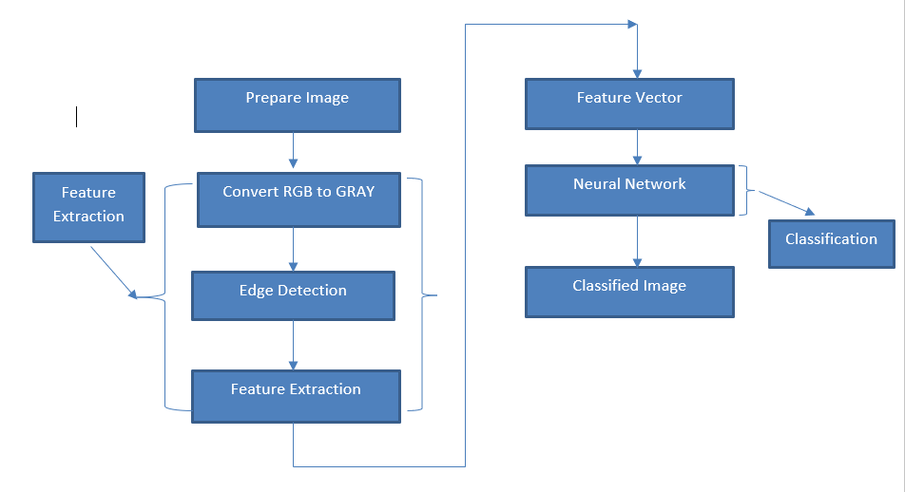
Project overview for American sign language

Slide 8
About American Sing Language(ASL)
American Sign Language is implemented from French sign language which was introduced by Thomas Hopins Gallaudet in United States.
ASL is similar to French sign language; Individuals who speak American Sign Language are able to effectively communicate in French Sign Language.
A variation of American Sign Language also exits. Similarly, to English which is international language, but it has unique variations between English spoken in England, United States or Australian, there are separate difference that have changed in sign language.

Slide 9
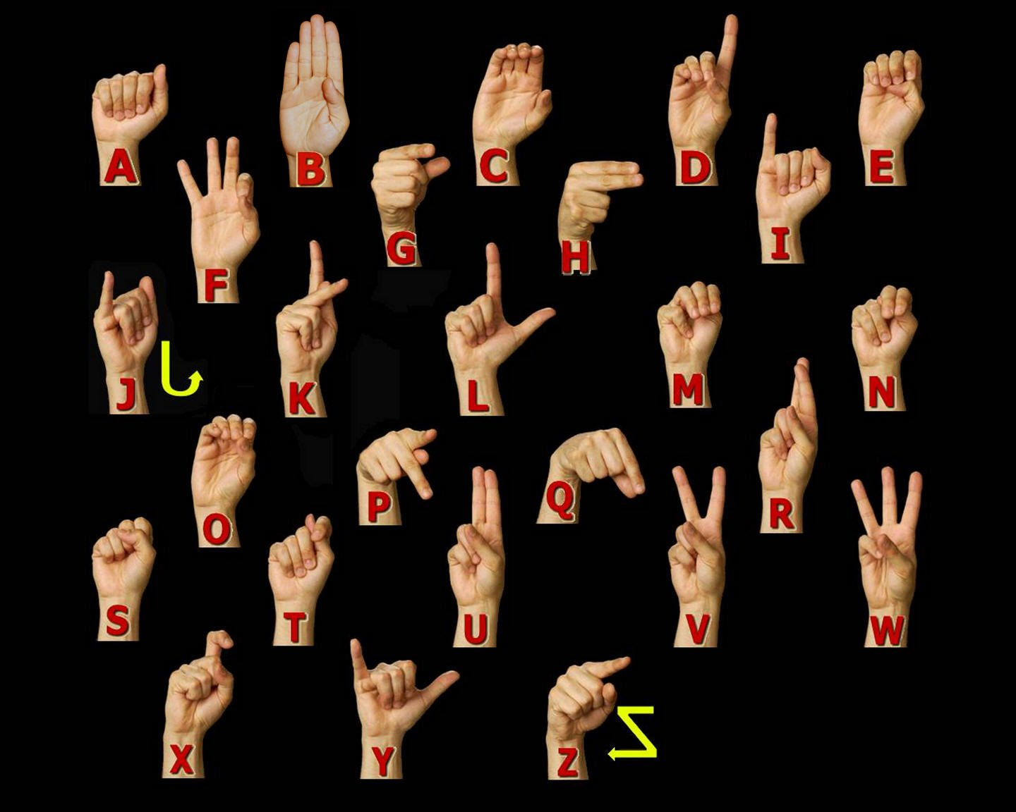
ASL Manual Alphabet

Slide 10
Dataset and variables:
I have created my own data set. This dataset was a collection of 36 which contain A to Z alphabet and 0 to 9 numbers digit.
In my dataset consist of A to Z alphabet and 0 to 9 numbers where I have used right hand to capture 1200 images for specific alphabet and numbers.
After that I implement code which convert flip image to right to left hand image.
The height and width ratios vary significantly but average approximately 50X50 pixel.
The dataset contains over 100,000 images in gray scale color. Additionally, People who want to add their images to this dataset than they can add.

Slide 11
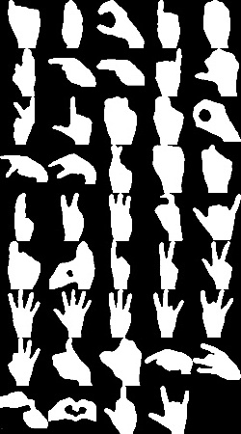
Data set Sample

Slide 12
Dataset Description and Image property
Property | Description
Alphabets | A to Z
Numbers | 0 to 9
Color | Gray Scale
Dimensions | 50x50
Height | 50 pixels
Width | 50 pixels

Slide 13
Capturing Images for Dataset
Used for detecting hand gesture using skin color, there are different approaches including skin color-based methods.
In my case, after detecting and subtracting the face and other background, skin recognition and a contour comparison algorithm were used to search for the hand and discard other background color objects for every frame captured from a webcam.
To analyze and extract relevant data about and object of interest from an image, one need to first get that object in the image. Hand posture detection refers to finding the place and size of hand within a sequence of images
I detected the skin area using the hue, saturation, value (HSV) color model since it has real-time performance and it is strong against alternations, scaling and lighting conditions. Then, the interested area of contours was compared with all the existing hand posture template contours to eliminate unwanted interest of area like objects existing in the image.

Slide 14
My Approach for Hand Detection
I propose an integrated system for detection, segmentation and tracking of the hand in a gesture recognition system using a single webcam. Some other methods that use color gloves , my method can detect the plain hand posture by integrating two useful features: skin color detection and contour matching.
my proposed hand posture finding algorithm has real-time performance and is strong against rotations, scaling, a cluttered background, and lighting conditions.
First, I will open camera which have 50 squares box to capture hand gesture. Second Put your hand in those boxes and make sure your hand covers all the squares box. Third, the skin color locus for the image was removed for the user’s skin color after face deletion. Then last step, the hand gesture was spotted by removing false positive skin pixels and identifying hand gesture and other real skin color regions using contours matching with the loaded hand gesture patterns contours.

Slide 15
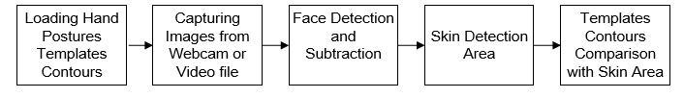
Hand posture detection steps

Slide 16
Neural Network Architecture
Single layer feed forward network.
Learning in feed-forward networks use for supervised learning, in which pairs of input and output values are supply into the network for many loop, so that the network trained the interconnection between the input and output.
Multilayer Feed Forward Network
Back propagation is a method used in artificial neural networks to calculate a gradient that is needed in the calculation of the weights to be used in the network
Self Organizing Map(Unsupervised Learning)

Slide 17
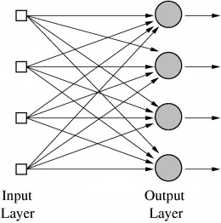
Single Layer feed forward network

Slide 18
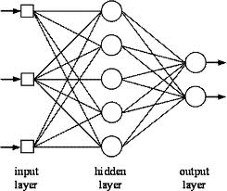
Multilayer feed forward network

Slide 19
Multilayer feed forward network
Input layer-It contains those units (Artificial neurons) which get contribution from the outside world on which system will learn, perceive about or generally process.
Output layer — It contains units that react to the data about how it’s learned any task.
Hidden layer — These layers are in between input and output layers. The main objective of hidden layer is to transfer the input into something that output unit can use and analysing.
Neural networks are fully connected when every node in hidden layer is fully connected to the every node in its previous layer(input) and to the next layer (output) layer.

Slide 20
Thank you

